Slide 1
6.5 Support Vector Machines

Slide 2
In this Section we begin by discussing an often used variation of the perceptron called the margin perceptron.
This perspective extends the notion of the perceptron described in the previous Section under the assumption that a dataset is linearly separable.
The margin perceptron will lead us to discuss Support Vector Machines, a popular perspective on linear classification again under the assumption of linear seperability.

Slide 3
This approach provides interesting theoretical insight into the two-class classification process - particularly under the assumption that the data is linearly separable.
However we will see that in practice the Support Vector Machines approach does not provide a learned decision boundary that substantially differs from those provided by logistic regression or, likewise, the perceptron.

Slide 4
The margin-perceptron

Slide 5
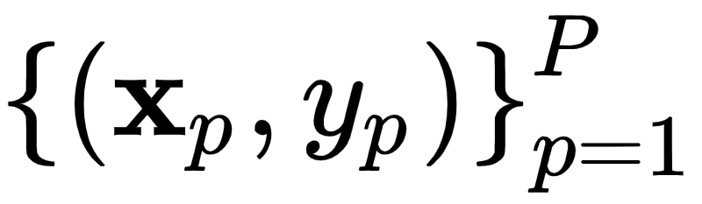
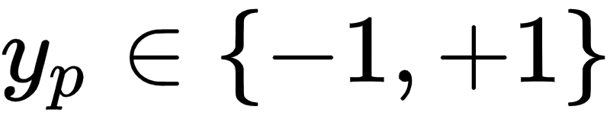
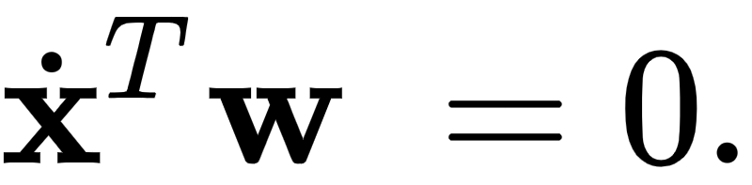
Suppose once again that we have a two-class classification training dataset of P points with the labels .
Suppose for the time being that we are dealing with a two-class dataset that is linearly separable with a known linear decision boundary
Suppose even further that this decision boundary passes evenly through the region separating our two classes, like the illustrated in the figure below.

Slide 6
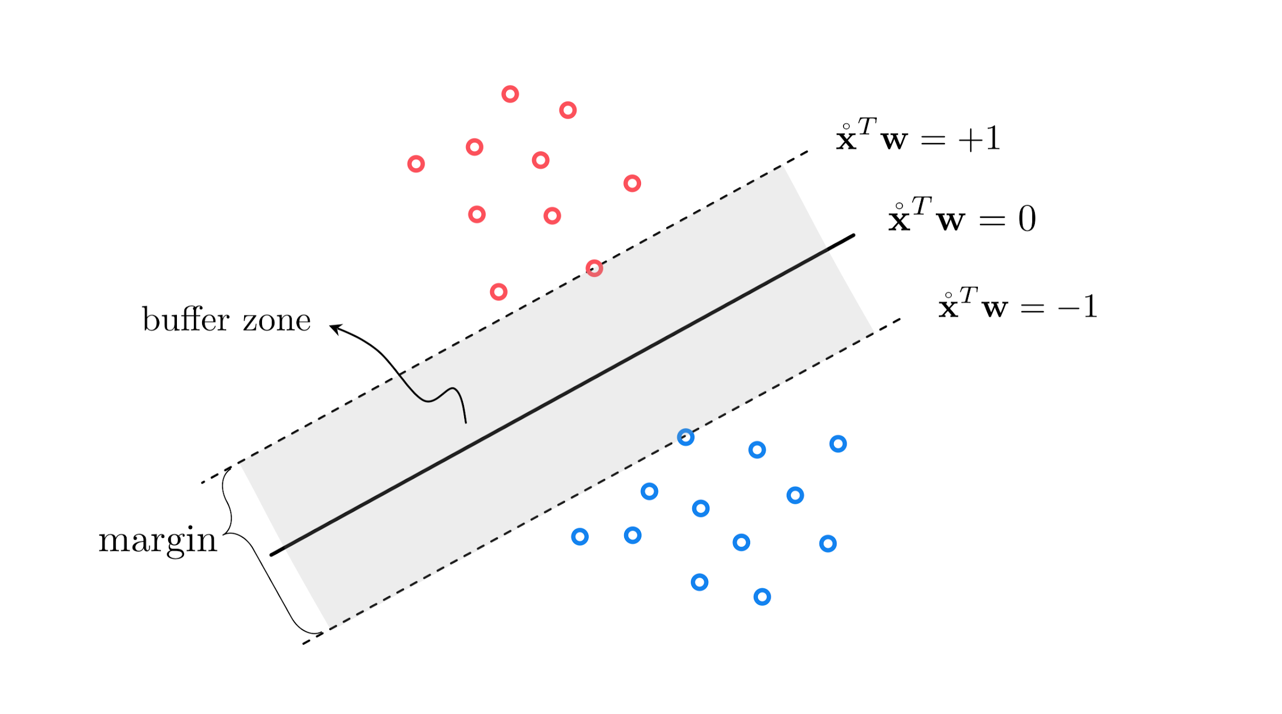

Slide 7
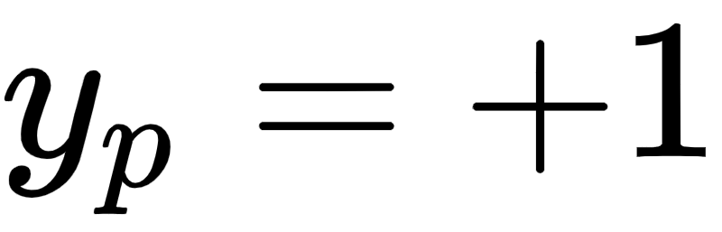
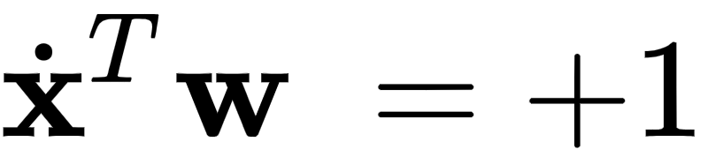
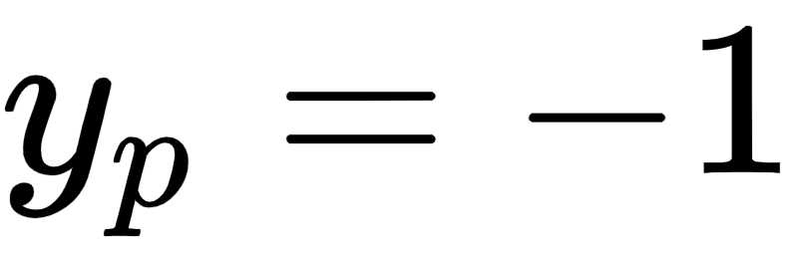
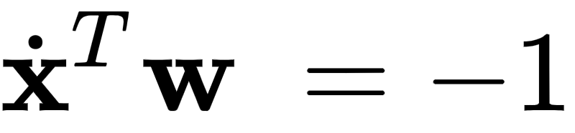
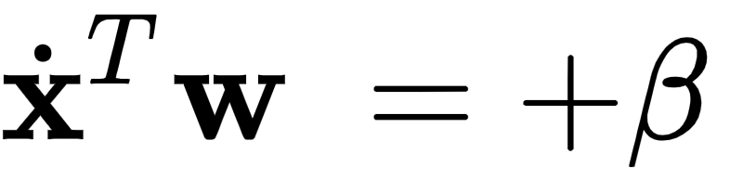
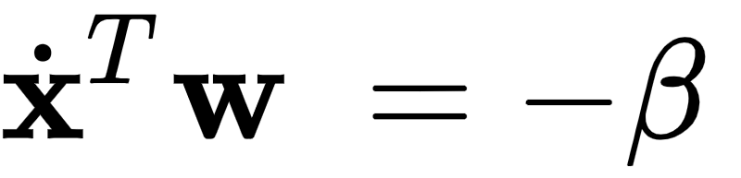
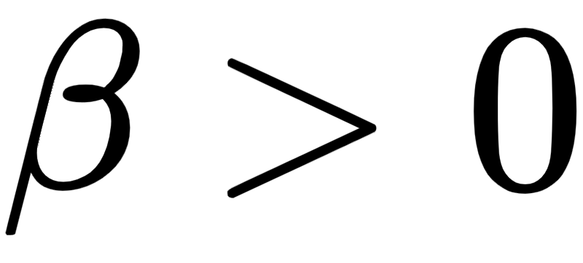
This separating hyperplane creates a buffer between the two classes confined between two evenly shifted versions of itself.
One version that lies on the positive side of the separator and just touches the class having labels (colored red in the figure) taking the form , and one lying on the negative side of it just touching the class with labels (colored blue in the figure) taking the form .
The translations above and below the separating hyperplane are more generally defined as and respectively, where

Slide 8
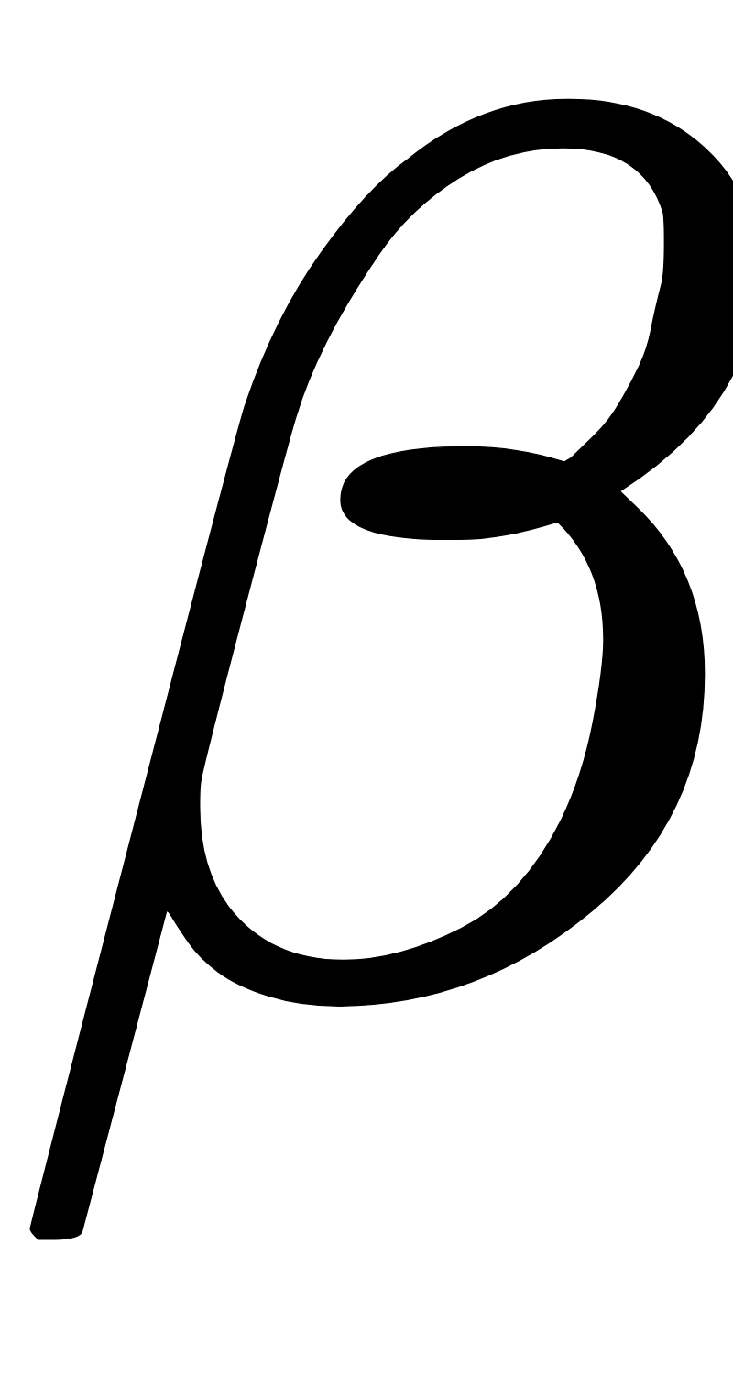
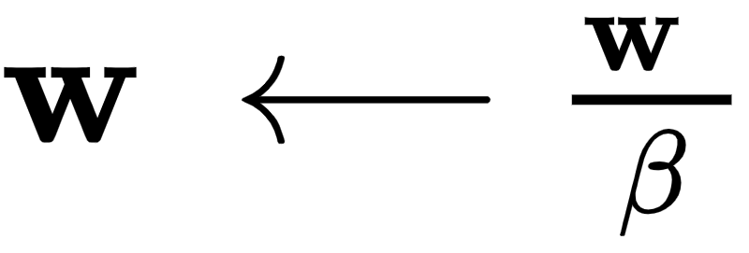
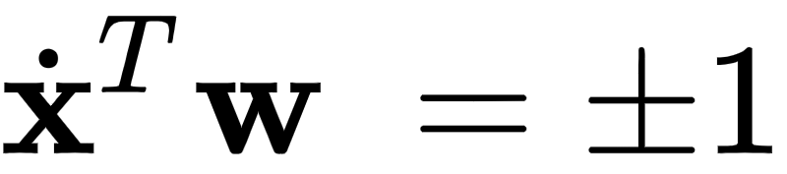
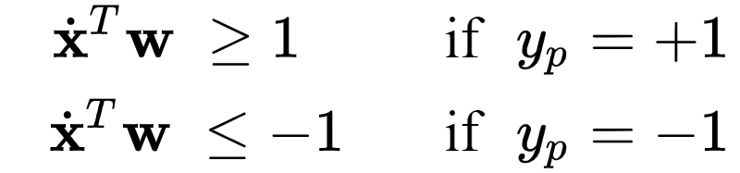
However by dividing off in both equations and re-assigning the variables as we can leave out the redundant parameter and have the two translations as stated .
The fact that all points in the +1 class lie exactly on or on the positive side of , and all points in the -1 class lie exactly on or on the negative side of can be written formally as the following conditions

Slide 9
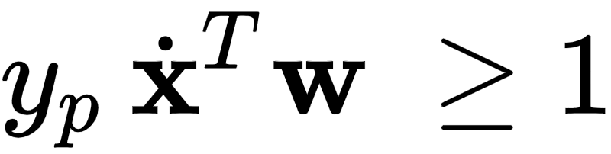

We can combine these conditions into a single statement by multiplying each by their respective label values, giving the single inequality which can be equivalently written as a point-wise cost
Again, this value is always nonnegative. Summing up all P equations of the form above gives the Margin-Perceptron cost

Slide 10
Notice the striking similarity between the original perceptron cost from the previous post and the margin perceptron cost above: naively we have just 'added a 1' to the non-zero input of the max function in each summand.
However this additional 1 prevents the issue of a trivial zero solution with the original perceptron discussed previously, which simply does not arise here.

Slide 11
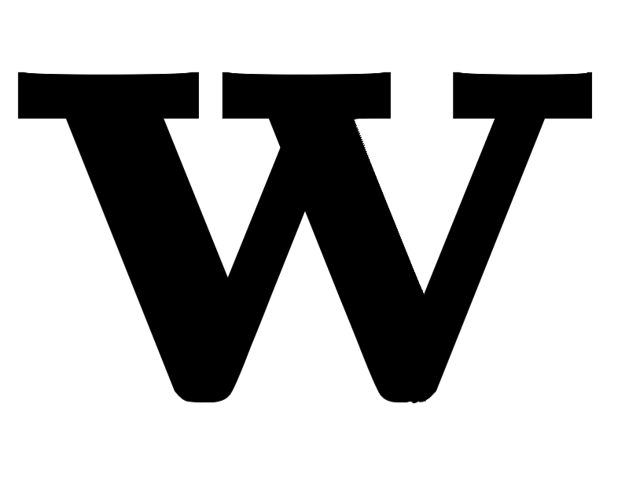
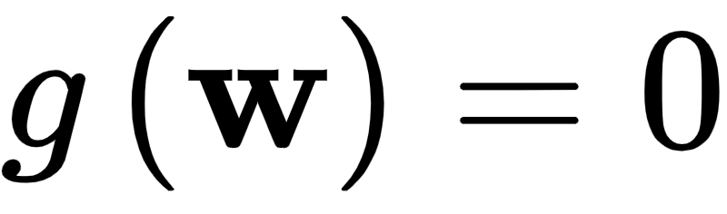
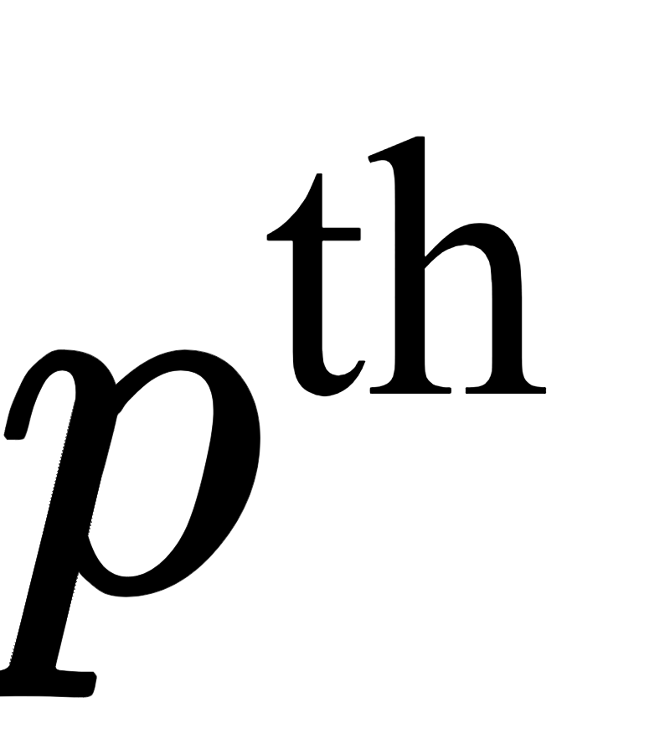
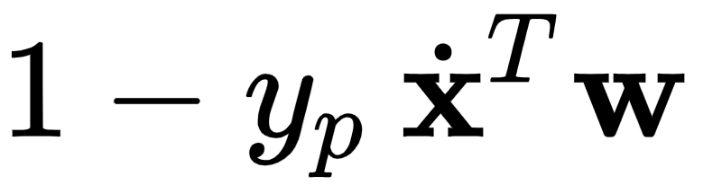
If the data is indeed linearly separable any hyperplane passing between the two classes will have parameters where .
However the margin perceptron is still a valid cost function even if the data is not linearly separable.
The only difference is that with such a dataset we can not make the criteria above hold for all points in the dataset.
Thus a violation for the point adds the positive value of to the cost function.

Slide 12
The softmax and Margin-Perceptron cost

Slide 13
If we have modeled something well but the associated cost function is difficult to minimize it can be more expedient to re-fashion the cost, even if we lose considerable modeling precision, if the new cost function is considerably easier to optimize.
Here 'easier to optimize' could mean a number of things - perhaps a steplength parameter is less sensitive (meaning a larger range of potential values will provide good results), or a broader set of optimization tools can be brought to bear.
The opposite holds as well - a cost function that is easy to minimize but models no useful phenomenon is a mere curiosity.

Slide 14
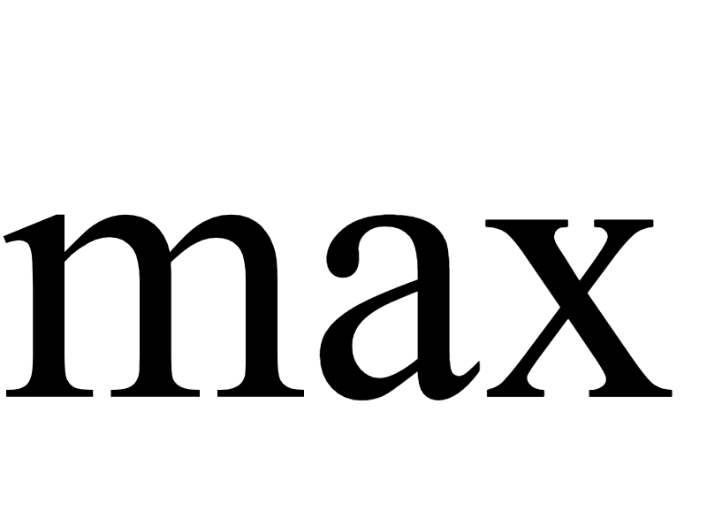
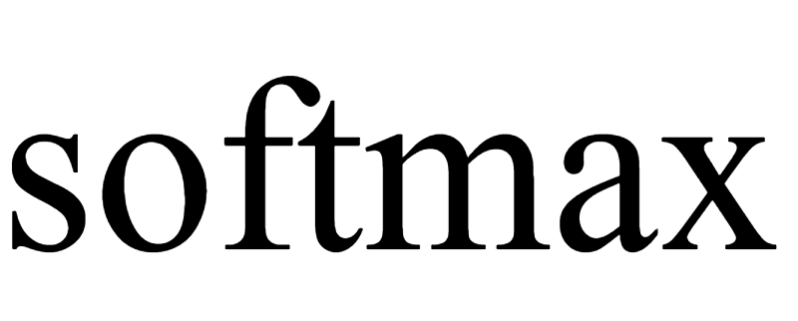

As with the perceptron, one way to smooth out the margin-perceptron here is by replacing the operator with . Doing so in one summand of the margin-perceptron gives the related summand
Right away if we were to sum over all P we could form a softmax-based cost function that closely matches the margin-perceptron.

Slide 15
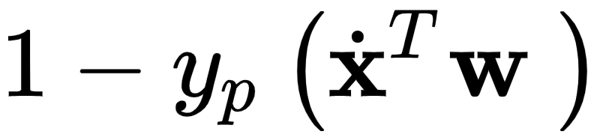
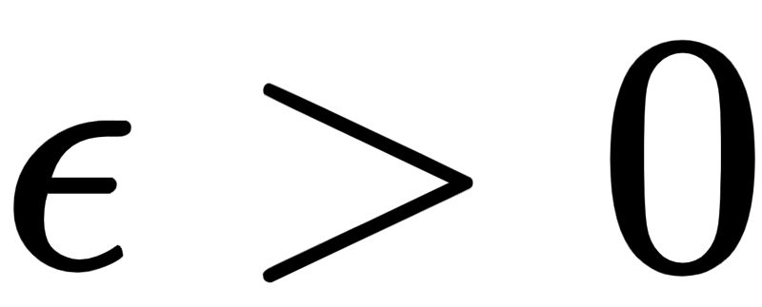
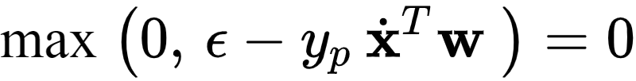
But note how in the derivation of the margin perceptron the '1' used in the component of the cost could have been any number we wanted - it was a normalization factor for the width of the margin and, by convention, we used '1'.
Instead we could have chosen any value in which case the set of P conditions stated in equation (2) would be equivalently stated as

Slide 16


So for all p and the Margin-Perceptron equivalently stated as
And the softmax version of one summand here being

Slide 17
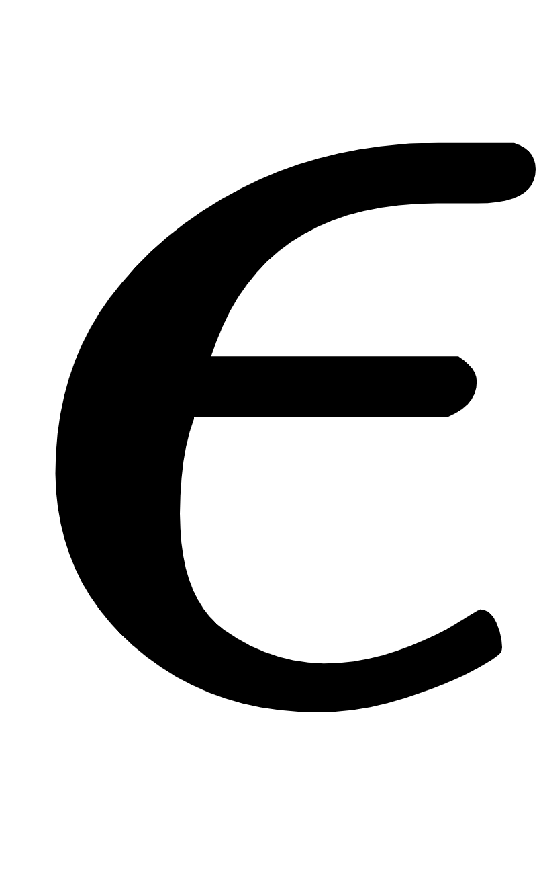

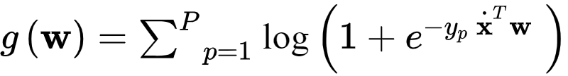
When is quite small we of course have that
That is, the same summand used for the (smoothed) perceptron and logistic regression.
Thus, we can in fact use the same softmax cost function here as a smoothed version of our Margin-Perceptron cost

Slide 18
From the perspective of the standard perceptron this realization is somewhat redundant.
A decision boundary recovered via the perceptron on a linearly separable dataset will almost always have a non-zero margin.
So this just says its smoothed version will do the same.

Slide 19
A quest for the hyperplane with maximum margin

Slide 20
When two classes of data are linearly separable infinitely many hyperplanes could be drawn to separate the data.
In the figure below we display two such hyperplanes for a given synthetic dataset.
Given that both classifiers (as well as any other decision boundary perfectly separating the data) would perfectly classify the data, is there one that we can say is the 'best' of all possible separating hyperplanes?

Slide 21
One reasonable standard for judging the quality of these hyperplanes is via their margin lengths, that is the distance between the evenly spaced translates that just touch each class.
The larger this distance is the intuitively better the associated hyperplane separates the entire space given the particular distribution of the data.
This idea is illustrated pictorially in the figure below.

Slide 22
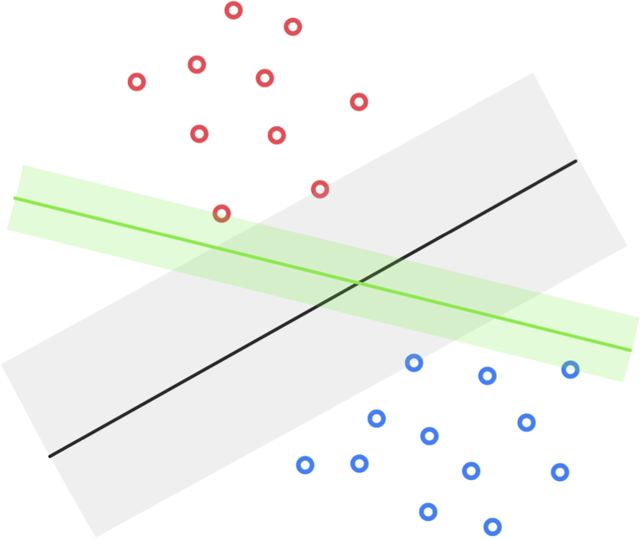

Slide 23
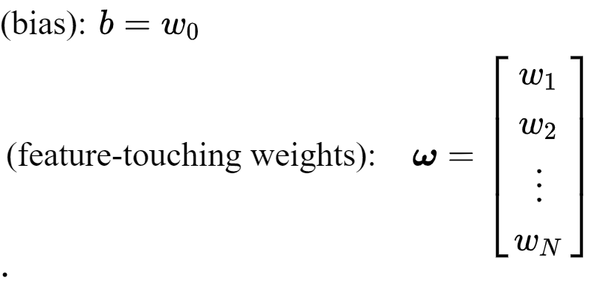
In our venture to recover the maximum margin separating hyperplane, it will be convenient to use our individual notation for the bias and feature-touching weights (used in e.g., [Section 6.2]

Slide 24
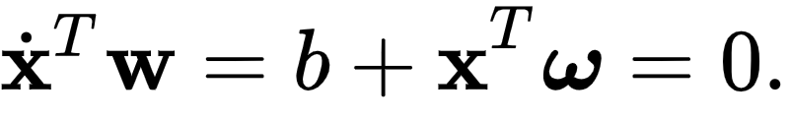
With this notation we can express a linear decision boundary as

Slide 25
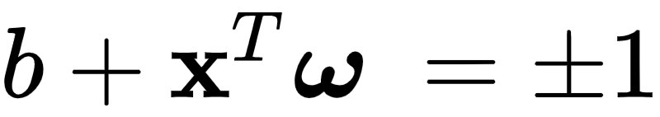

To find the separating hyperplane with maximum margin we aim to find a set of parameters so that the region defined by , with heach translate just touching one of the two classes, has the largest possible margin.
As shown in the figure below the margin can be determined by calculating the distance between any two points (one from each translated hyperplane) both lying on the normal vector .

Slide 26
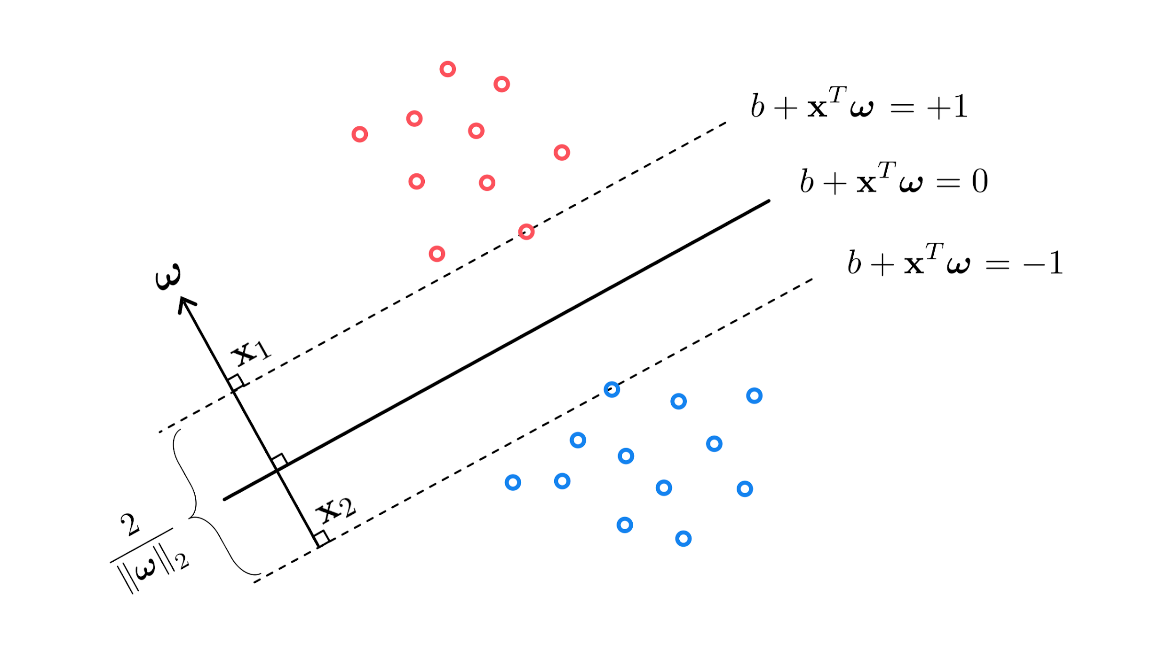

Slide 27
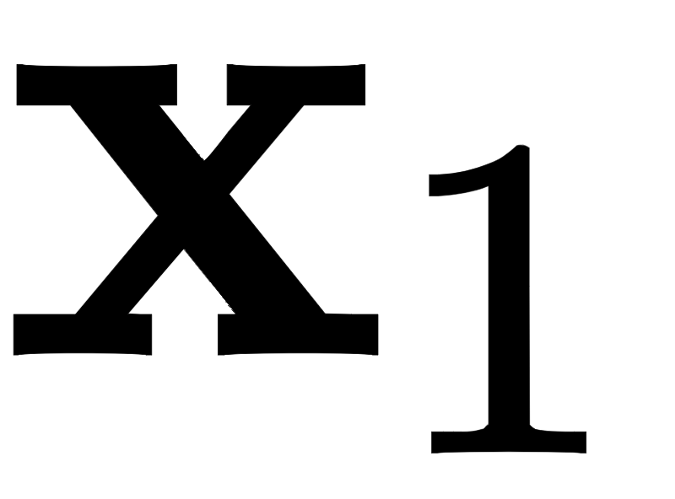
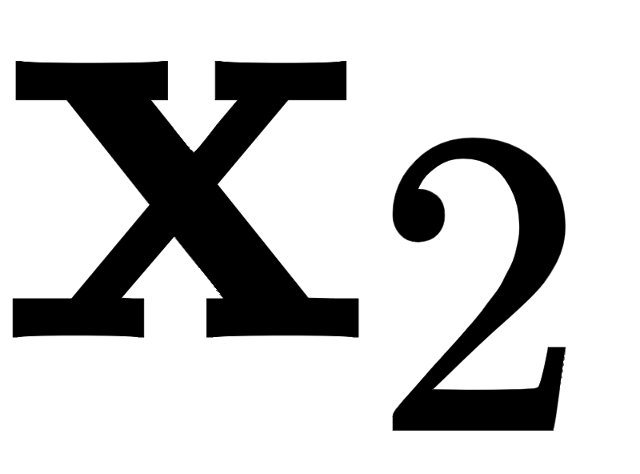
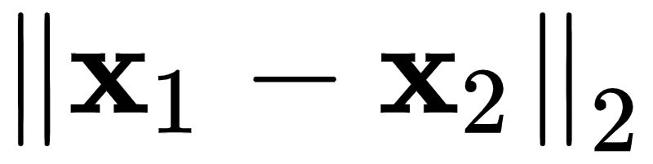
Denoting by and the points on vector belonging to the positive and negative translated hyperplanes, respectively, the margin is computed simply as the length of the line segment connecting and , i.e.,
The margin can be written much more conveniently by taking the difference of the two translates evaluated at and respectively, as

Slide 28
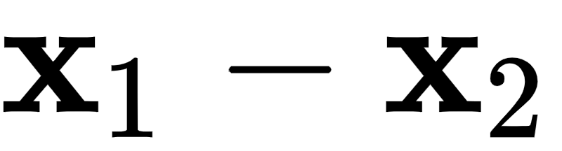
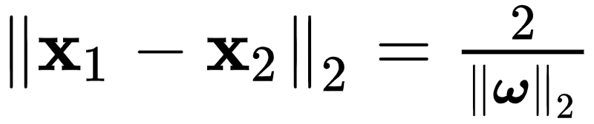
Using the inner product rule, and the fact that the two vectors and are parallel to each other, we can solve for the margin directly in terms of , as
Therefore finding the separating hyperplane with maximum margin is equivalent to finding the one with the smallest possible normal vector .

Slide 29
The hard-margin and soft-margin SVM problems

Slide 30
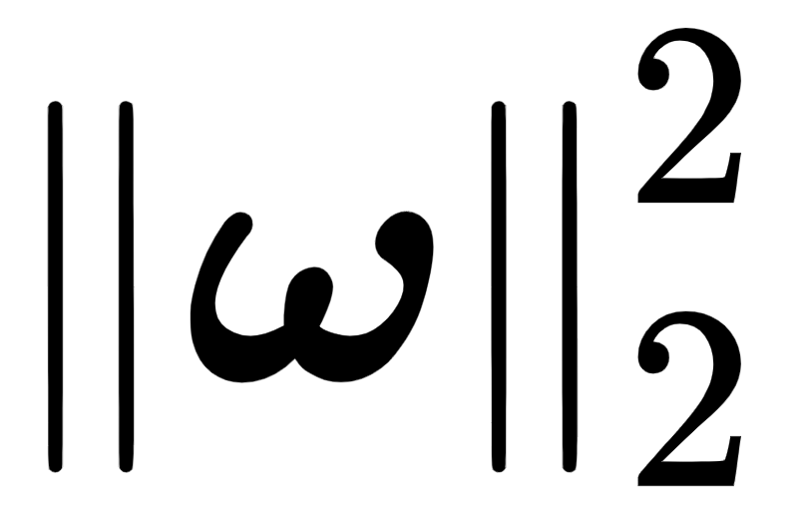
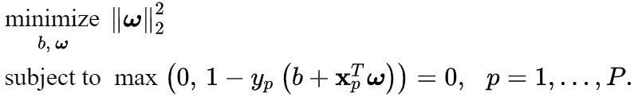
In order to find a separating hyperplane for the data with minimum length normal vector we can simply combine...
...our desire to minimize ...
...subject to the constraint that the hyperplane perfectly separates the data (given by the margin criterion described above).
This gives the so-called hard-margin support vector machine problem

Slide 31
The set of constraints here are precisely the margin-perceptron guarantee that the hyperplane we recover separates the data perfectly.
Unlike some of the other constrained optimization problems we have previously discussed this cannot be solved in closed form, but must be optimized iteratively.

Slide 32
While there are constrained optimization algorithms that are designed to solve problems like this as stated.
We can also solve the hard-margin problem by relaxing the constraints and forming an unconstrained formulation of the problem.
To do this we merely bring the constraints up, forming a single cost function to be minimized

Slide 33
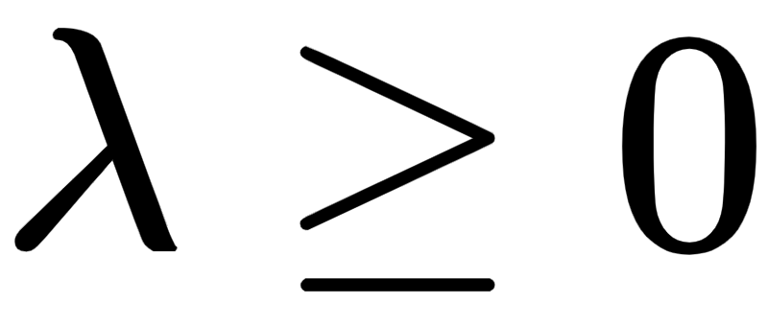
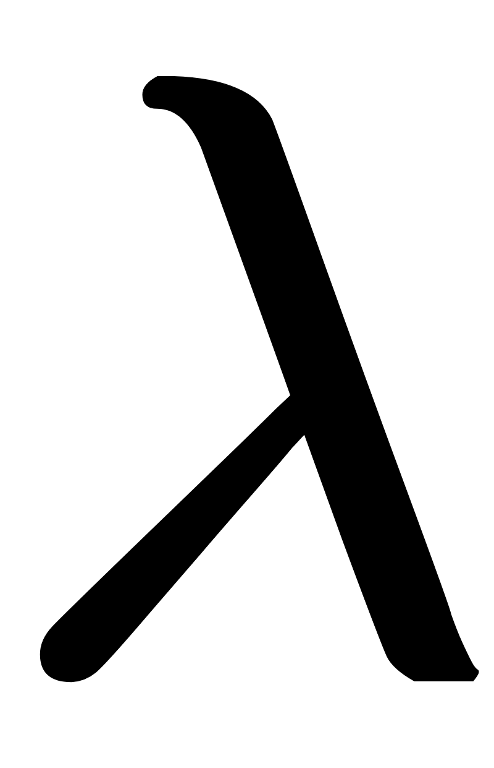
Here the parameter is called a penalty or regularization parameter (we have seen the notion of regularization in the previous Section as well).
When is set to a small positive value we put more 'pressure' on the cost function to make sure the constraints
In theory when is made very small the formulation above matches the original constrained form.

Slide 34
Because of this , is often set to be quite small in practice.
This regularized form of the Margin-Perceptron cost function is referred to as the soft-margin support vector machine cost.

Slide 35
Comparing the SVM decision boundary on linearly separable data

Slide 36
In this example we compare the support vector machine decision boundary learned to three boundaries learned via the margin-perceptron.
All of the recovered boundaries perfectly separate the two classes, but the support vector machine decision boundary is the one that provides the maximum margin (right panel)...
...while those recovered by the margin-perceptron (left panel, each colored differently) can ostensibly be any of the infinitely many linear decision boundaries that separate the two classes.

Slide 37
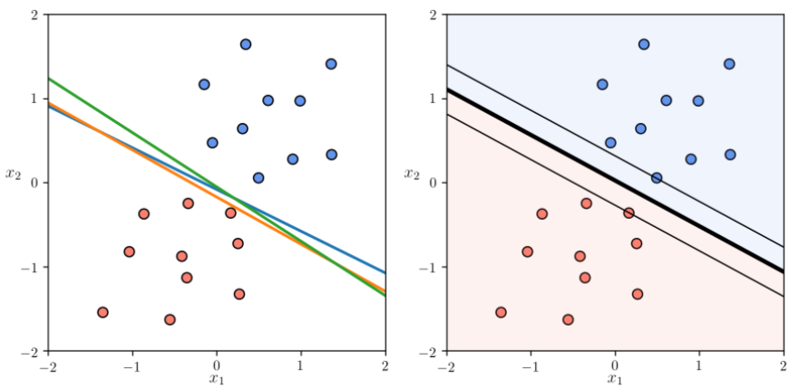

Slide 38
Note how in the right panel the margins pass through points from both classes - equidistant from the SVM linear decision boundary.
These points are called support vectors, hence the name support vector machine.

Slide 39
The SVM and noisy datasets

Slide 40

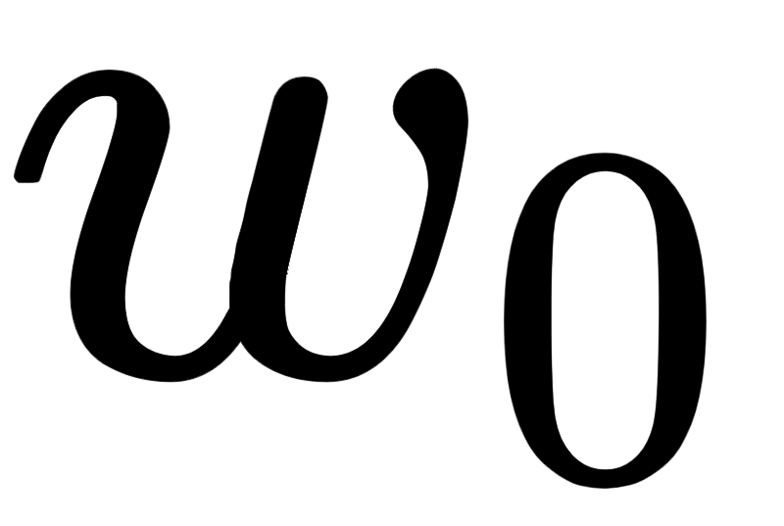
A very big practical benefit of the softmargin SVM problem is that it allows us it to deal with noisy imperfectly (linearly) separable data - which arise far more commonly in practice than datasets that are perfectly linearly separable.
'Noise' is permittable with the softmargin problem since regardless of the weights b and , we always have some data point which is misclassified, i.e., for some p that
Such a case makes the first hard-margin formulation of SVMs infeasible, as no such and even exist that satisfy the constraints.

Slide 41
Because we commonly deal with non-separable datasets in practice the softmargin form of SVM is the version that is more frequently used.
However notice that once we forgo the assumption of perfectly (linear) separability the added value of a 'maximum margin hyperplane' proided by the SVM solution disappears since we *no longer have a margin to begin with*.

Slide 42
Thus with many datasets in practice the softmargin problem does *not* provide a solution remarkably different than the perceptron or even logistic regression.
Actually - with datasets that are not linearly separable - it often returns *exactly* the same solution provided by the perceptron or logistic regression.

Slide 43
To see why this could be the case notice what happens to our softmargin SVM problem if we *smooth* the Margin-Perceptron portion of the cost using the *softmax* (as detailed previously).
This gives a smoothed out soft-margin SVM cost function of the form
which we can also identify as a regularized softmax perceptron or logistic regression.

Slide 44
Thus we can see that all three methods of linear two-class classification we have seen are very deeply connected, and why they tend to provide similar results on realistic (not linearly separable) datasets.

